Slide 1

Analysis & Predictive Modeling of NBA Finals:
HOME TEAM - WIN PROBABILITY
Based on collection of NBA Final games data from the 2004 season to Dec. 2020 season.
Created by: Jonny Tesfahun
Email
Jonnymtesfahun@gmail.com
LinkedIn
www.linkedin.com/in/jonny-m-tesfahun
GitHub
https://github.com/Jonny

Slide 2
INDEX
03 / WHO ARE THE STAKEHOLDERS ?
05 / WHAT IS THE PROBLEM ?
07 / WHAT IS THE RELEVANCE ?
09 / THE DATA ANALYSIS
15 / MACHINE LEARNING RESULTS

Slide 3
1. Who Are the Stakeholders ?

Slide 4
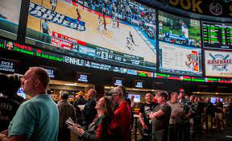
Who Are the Stakeholders ?
01
Sports Betting Casinos & Sports Betters Looking for an Edge
- Sports betting numbers reveal that the annual worldwide gross gambling yield is higher than $400 billion.
- Online worldwide gambling market amounted to over $40 billion in 2016.
- Gambling houses need new ways to stay ahead of gamblers as tech advances.
- Gamblers are always looking for ways to beat the house.

Slide 5
2. What is the Problem ?

Slide 6
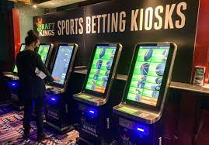
What is the Problem ?
02
Accurately Predicting a Future Game Outcome Based on Past Statistics
- One of the biggest mistakes gamblers make when betting on sports is looking at stats without breaking them down in a way that gives them an accurate comparison.
- According to GamblingSites.org, the 2nd hardest sport to bet on is basketball. The reason for this is the unpredictable nature and long season.

Slide 7
3. What is the Relevance ?

Slide 8
What is the Relevance ?
03
Personal Experience
Data Methodology
* Played competitive basketball since 7 y/o. till C.C.
* The goal of the model is to predict the likelihood a home team will win during NBA Finals game. Thus, how accurately can the model predict in games home team won, which is the target of the dataset.
* Seattle Super Sonics were my favorite team.
* Now just a player fan of Kevin Durant and LeBron James,
* Analyzed 4 different models (Logistic Regression & Decision Tree Classifier) with and without Principal Component Analisis (PCA).
* Always wanted to know if a basketball game win could be predicted at 90% accuracy.

Slide 9
4. The Data Analysis

Slide 10
Data Analysis
04
Data Preparation
* Cleaned data for any Outliers and Errors
* Using previous game statistics was able to make predictive model by deleting the result of previous game. And re-indexing that results column.
* This allowed for a future projection of results based on current game statistics.

Slide 11
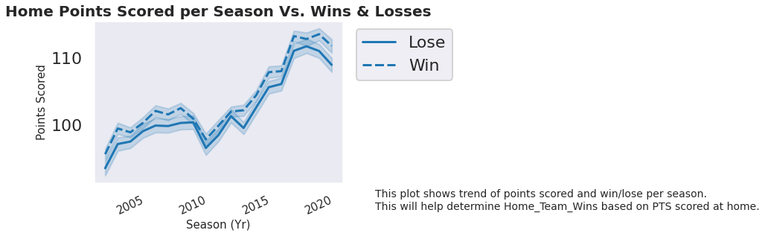
Data Analysis
04
Graph 1:
Home Team Points consistently increasing over the seasons which shows is tightly correlated to Home Team Wins.
In 2010 and 2014, Home Points Scored were less likely to lead to Home Team Wins than any other season.

Slide 12
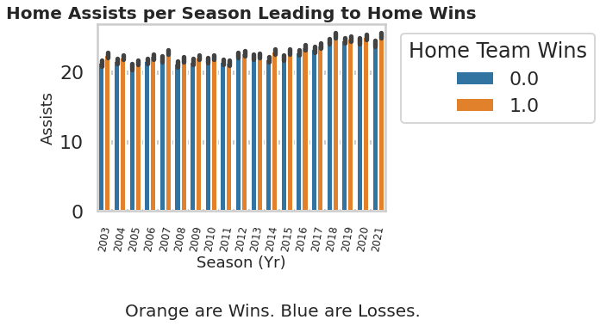
Data Analysis
04
Graph 2:
On average, since 2003 Home Teams with 20 or more assist at home were 56.6% more likely to win the Home Game.

Slide 13
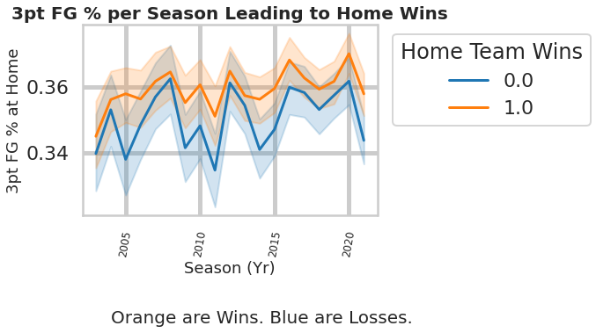
Data Analysis
04
Graph 3:
This graph shows that since 2007, teams who shoot greater than 36% at 3pt Field Goal Percentage were 70.6% more likely to win the Home Game.

Slide 14
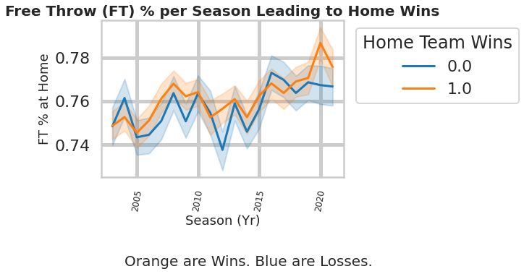
Data Analysis
04
Graph 4:
This graph shows that FT% is somewhat an outlier for the target data. Meaning teams that shoot a high FT% at home do not guarantee Home Game Wins. In fact, it may be the opposite.

Slide 15
5. Machine Learning Results

Slide 16
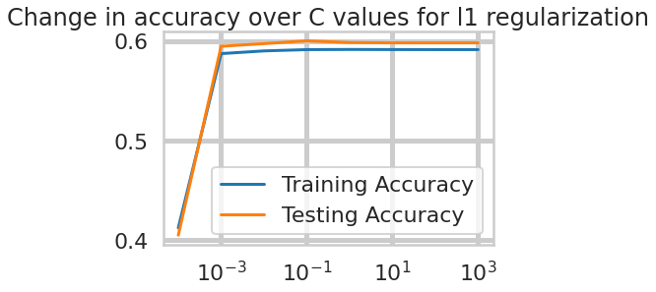
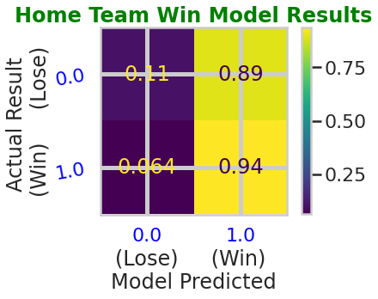
Machine Learning Results
05
Best Model = Tuned Logistic Regression with no PCA

Slide 17
Machine Learning Results
05
Strengths, Limitations, & Recommendations
Strengths:
- This model’s accuracy on predicting future Home Team Wins is 60.02%.
- Recall measures how many of the positive cases the model correctly predicted. And this model was able to score 93.55%. Which is fantastic for this type of model.
Limitations:
- Many changes can be made to parameters or inputs to increase Accuracy but the cost may be CPU performance. Due to lack of CPU performance, I was not able to utilize Randomized Search CV which could have increased accuracy more.
Recommendation:
- Increase amount of losing team data. Current model only has 41% of losing team data. That would make model more accurate in predicting losses.
- More data outside the scope of game statistics should be used to increase accuracy even more. For instance, injury report, ejections or suspensions, and positive (wining) or negative (losing) streaks.

Slide 18
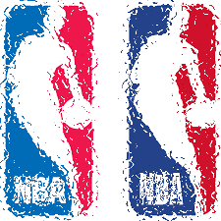
Thank you.
Created by: Jonny Tesfahun
Email
Jonnymtesfahun@gmail.com
Linkedin
www.linkedin.com/in/jonny-m-tesfahun
GitHub
https://github.com/Jonny

